Slide 1
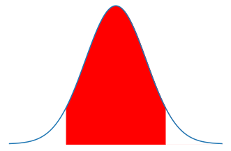





$$\left|Z_{\frac{α}{2}}\right|$$
$$\left|Z_{\frac{α}{2}}\right|$$
CI
DMOE
DMOE
$\overline{X}−s_{\overline{x}}∗$ $\left|Z_{\frac{α}{2}}\right|$
$$\overline{X}$$
$\overline{X}+s_{\overline{x}}∗$ $\left|Z_{\frac{α}{2}}\right|$

Slide 2
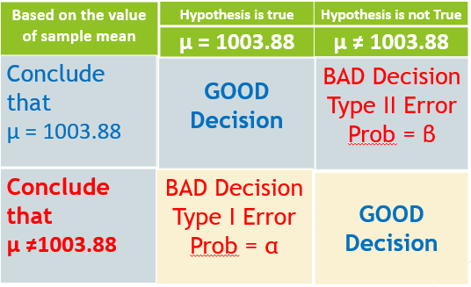
Mutually Exclusive
1 - α
Mutually Exclusive
Case 1
Case 3
1 - β
Case 2
Case 4

Slide 3
Based on the value of sample mean
Hypothesis is not True
μ ≠ 1003.88
Conclude that μ = 1003.88
BAD Decision Type II Error Prob = β
Conclude that μ ≠1003.88
GOOD Decision

Slide 4
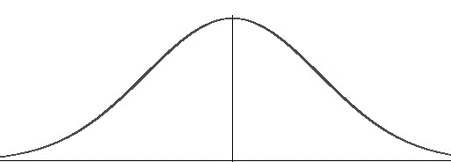


μ
β
μ_{n} > μ
β
$${\overline{X}}_{critical}$$
μ_{n} > μ

Slide 5

μ
β
μ_{n} < μ
β
μ_{n} < μ
$${\overline{X}}_{critical}$$

Slide 6


α/2
α/2
μ
β_{left}
Β - β_{left}
μ_{n} < μ
β_{left}
β - β_{left}
$${\overline{X}}_{low_critical}$$
μ_{n} > μ
$${\overline{X}}_{high_critical}$$

